Slide 1
Airbnb Analysis: A 2019 San Diego Report
20XX
Rida Shahwar

Slide 2
PROBLEM STATEMENT
Since 2008, guests and hosts have used Airbnb to expand on traveling possibilities and present a more unique, personalized way of experiencing the world. This dataset describes the listing activity and metrics in San Diego, California for 2019. This data file includes all the information needed to learn more about hosts, geographical availability, and necessary metrics to make predictions and draw conclusions.
20XX
Slide Subtitle

Slide 3
INSIGHTS THAT CAN BE GAINED FROM THE DATA
20XX
Host Metrics
Listing Metrics
Geographical Metrics

Slide 4
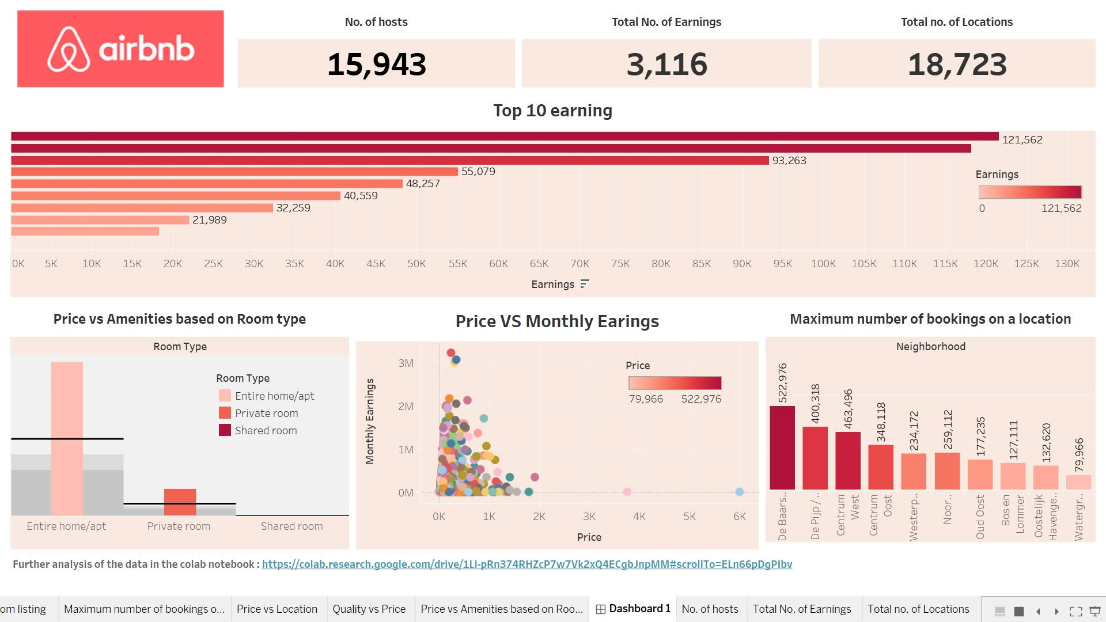
DASHBOARD DESIGN
20XX

Slide 5
INSIGHTS MENTIONED IN THE DASHBOARD
No. of Hosts
Total no. of Earnings
Total No. of locations
Top 10 Earning based on hosts
Price vs Amenities based on Room types
Price vs Monthly Earnings
Maximum number of bookings on a location

Slide 6
LINKS TO THE PROJECTS
Python
Tableau
https://colab.research.google.com/drive/1Li-pRn374RHZcP7w7Vk2xQ4ECgbJnpMM?usp=sharing
Air bnb Analysis | Tableau Public

Slide 7
THANK YOU!
20XX
Rida Shahwar

